Slide 1

Lecture 10
Software Design and Architecture
Rana Taimur Khan
Lecturer GCUF

Slide 2
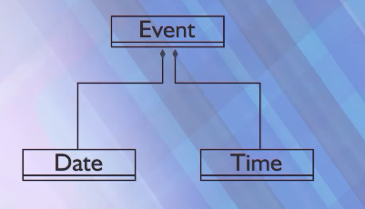
Object Oriented programming Implementing Composition
Example:

Slide 3
Object Oriented programming Implementing Composition
Implementation:
Class Date
{
public:
Date();
Date(int,int,int);
//some setters getters and utility functions
Void printDate();
private:
int month;
int day;
int year;
};

Slide 4
Object Oriented programming Implementing Composition
Implementation:
Class Time
{
public:
Time();
Time(int,int);
//some setters getters and utility functions
Void printTime();
private:
int hr;
int min;
};

Slide 5
Object Oriented programming Implementing Composition
Implementation:
class Event{
public:
Event (int hours= 0, int minutes =0,
int m=I , int d = I, int y=1900,
string name = “Start of 20th Century ”);
//setters, getters and other utility functions
void printEventData();
private:
string eventName;
Time eventTime;
Date eventDay;
};

Slide 6
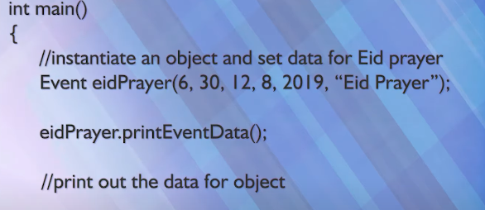
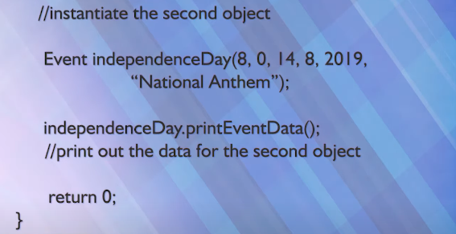
Object Oriented programming Implementing Composition
Implementation:

Slide 7
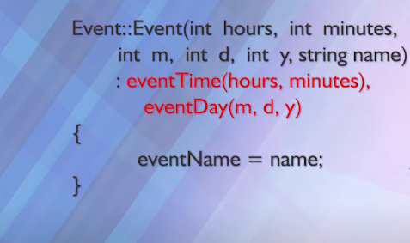
Object Oriented programming Implementing Composition
Implementation:

Slide 8
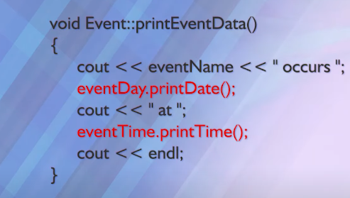
Object Oriented programming Implementing Composition
Implementation:

Slide 9
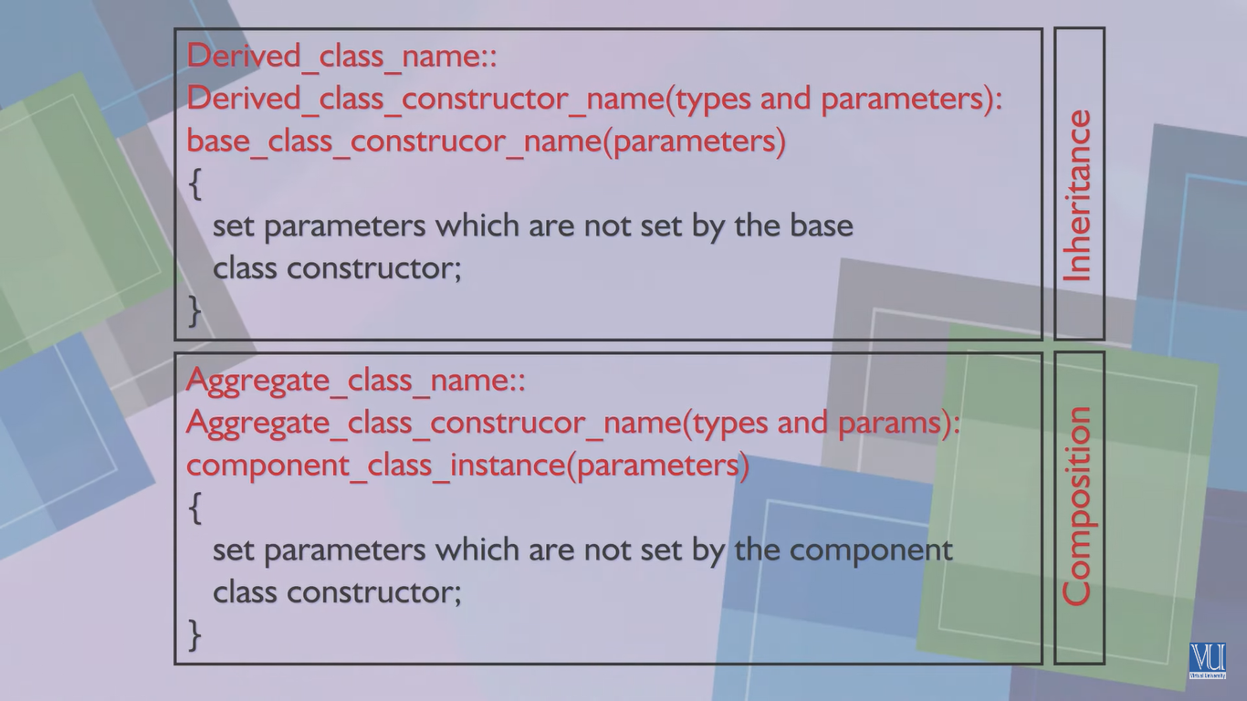
Object Oriented Programming Inheritance vs Composition

Slide 10
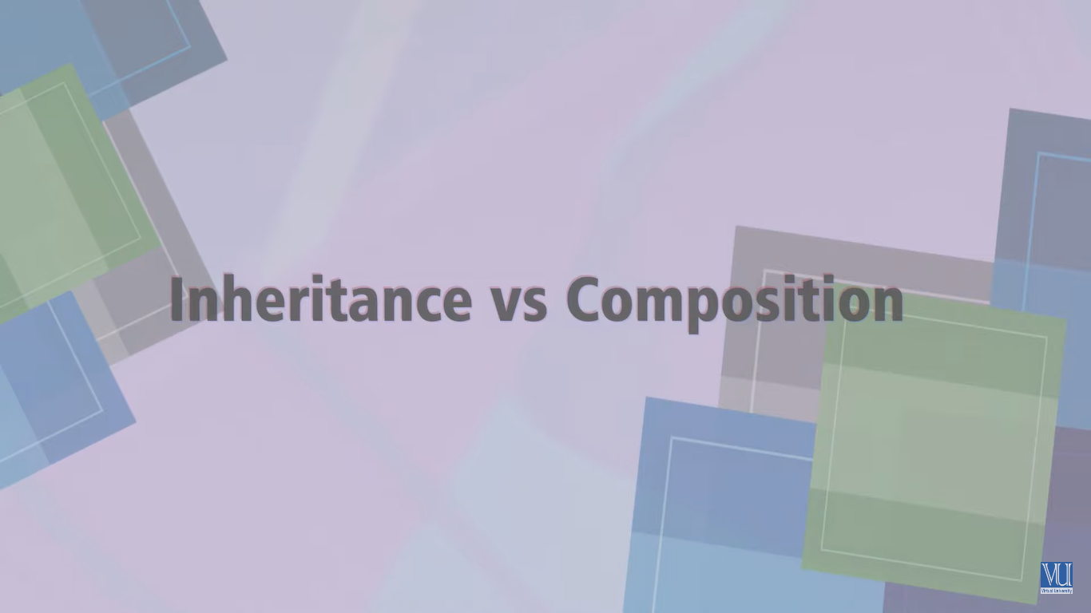

Slide 11
Object Oriented Programming Inheritance vs Composition
Inheritance vs Composition:
The main advantage inheritance has over composition is that it allows objects of the derived class to be dynamically bound in the same hierarchy as its base classes.
It is also necessary where virtual methods must be overridden by the derived class a composite aggregate cannot do this.

